Slide 1

VISA APPROVAL PREDICTION
GUIDE : Ms P. Mansa Devi,
Assistant Professor

Slide 2
INTRODUCTION
H-1B is a type of non-immigrant visa in the United States that allows foreign nationals to work in occupations that require specialized knowledge and a bachelor’s degree or higher in the specific specialty.
This visa requires the applicant to have a job offer from an employer in the US before they can file an application to the US immigration service (USCIS). USCIS grants 85,000 H-1B visas every year, even though the number of applicants far exceed that number.
The dataset we collected from kaggle under the name of "H1B DISCLOSURE DATASET"

Slide 3
BACKGROUND STUDY
Background information regarding the algorithms used in this work is also provided. The main aim of this project is to predict the certification status of the visa applications. For this purpose, the concept of classification will be used. That is, when all the attributes are provided, the classifying model is trained on historical data of this application domain and probability of rows belonging to one class or status over the other is determined.
As part of our research we found some relevant papers as reference and studied them.some of them used the same data that we had while others used similar methods and we came across various methods as well which might be helpful for the project.
PREDICTION OF H1B VISA USING MACHINE LEARNING ALGORITHMS
A Predictive Model for H1B Visa Petition Approval
H-1B Visa Data Analysis and Prediction by using K-means Clustering and Decision Tree Algorithms

Slide 4
PURPOSE
In this project we are going to predict our case status of an application submitted by the employer to hire non-immigrant workers under the H-1B visa program. Employer can hire non-immigrant workers only after their LCA petition is approved. The approved LCA petition is then submitted as part of the Petition for a Non immigrant Worker application for work authorizations for H-1B visa status.

Slide 5
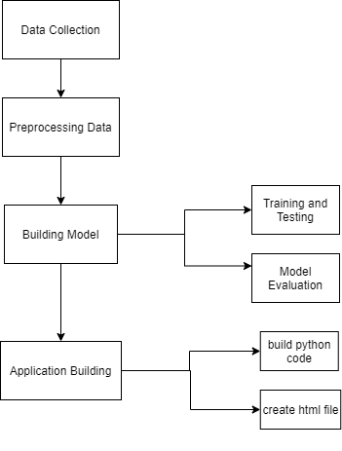

Slide 6
PROPOSED METHOD
The main objective of project is to build a supervised classification model to classify the visa applications. The visa petitions are classified into classes from the case status attribute of dataset. 80% of data is used for training the model and 20% of data is for testing the data. The accuracy, precision and recall of the learning models and see which model works best for predicting the outcome of a visa petition

Slide 7
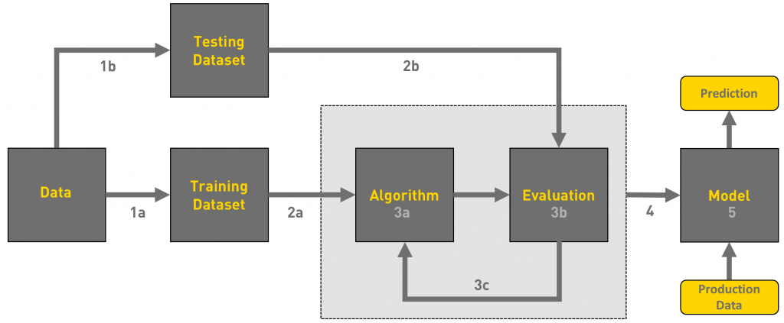
BLOCK DIAGRAM

Slide 8
DATA PREPROCESSING
In any Machine Learning process, Data Preprocessing is that step in which the data gets transformed, or Encoded, to bring it to such a state that now the machine can easily parse it.
In other words, the features of the data can now be easily interpreted by the algorithm.
Import libraries and dataset
Data Visualization and Handling missing values
Label and one hot encoding
Feature scaling
Data splitting into train and test set

Slide 9
TRAINING AND TESTING THE MODEL
Train/Test is a method to measure the accuracy of your model.
It is called Train/Test because you split the data set into two sets: a training set and a testing set.
80% for training, and 20% for testing.
You train the model using the training set.
You test the model using the testing set.
Train the model means create the model.
Test the model means test the accuracy of the model.

Slide 10
MODEL EVALUATION
Model evaluation aims to estimate the generalization accuracy of a model on future data. Methods for evaluating a model's performance.
Model Evaluation is an integral part of the model development process. It helps to find the best model that represents our data and how well the chosen model will work in the future. To avoid overfitting, both methods use a test set to evaluate model performance.

Slide 11
Navie Bayes:
Naive Bayes classifiers are a collection of classification algorithms based on Bayes' Theorem.It is a simple and interpretable model which assumes all features are conditionally independent given labels and are in gaussian distribution.
It calculates P(x/y=0), P(x/y=1) and P(y) by taking their maximum likelihood estimates in the joint likelihood of the data. While making a prediction, it considers both P(y=1) and P(y=0) on the Bayes rule and compares the two.
P(A|B) = P(B|A) * P(A) / P(B)

Slide 12
DECISION TREE CLASSIFIER
Decision Tree Classifier is a simple and widely used classification technique.
It applies a straightforward idea to solve the classification problem.
Decision Tree Classifier poses a series of carefully crafted questions about the attributes of the test record.
Each time it receive an answer, a follow-up question is asked until a conclusion about the class label of the record is reached.

Slide 13
ID3 ALGORITHM FOR BUILDING A DECISION TREE
ID3 stands for Iterative Dichotomiser 3 and is named such because the algorithm iteratively which means repeatedly, dichotomizes which means divides features into two or more groups at each step.
Invented by Ross Quinlan, ID3 uses a top-down greedy approach to build a decision tree.
In simple words, the top-down approach means that we start building the tree from the top and the greedy approach means that at each iteration we select the best feature at the present moment to create a node.
Most generally ID3 is only used for classification problems with nominal features only.

Slide 14
ID3 STEPS
Calculate the Information Gain of each feature.
Considering that all rows don’t belong to the same class, split the dataset S into subsets using the feature for which the Information Gain is maximum.
Make a decision tree node using the feature with the maximum Information gain.
If all rows belong to the same class, make the current node as a leaf node with the class as its label.
Repeat for the remaining features until we run out of all features, or the decision tree has all leaf nodes.

Slide 15
APPLICATION BUILDING
Pickle in Python is primarily used in serializing and deserializing a Python object structure. In other words, it's the process of converting a Python object into a byte stream to store it in a file/database, maintain program state across sessions, or transport data over the network
Flask is a micro web framework written in Python. It has no database abstraction layer, form validation, or any other components where pre-existing third-party libraries provide common functions.

Slide 16
CREATING HTML CODE
Application only displays a simple message without any HTML. Web applications mainly use HTML to display information for the visitor, so now we need to work on incorporating HTML files in our app, which can be displayed on the web browser.
We need to write the html code for our application so that Can predict the results using the inputs provided within short duration of time.

Slide 17
RESULT
After splitting the data in ratio 80:20, we applied decision tree algorithm on the data to predict the outcome.
While using the navie bayes algorithm we obtained accuracy 0.8420763630511138.
While using the decision tree algorithm we obtained accuracy 0.9734253552595454.

Slide 18
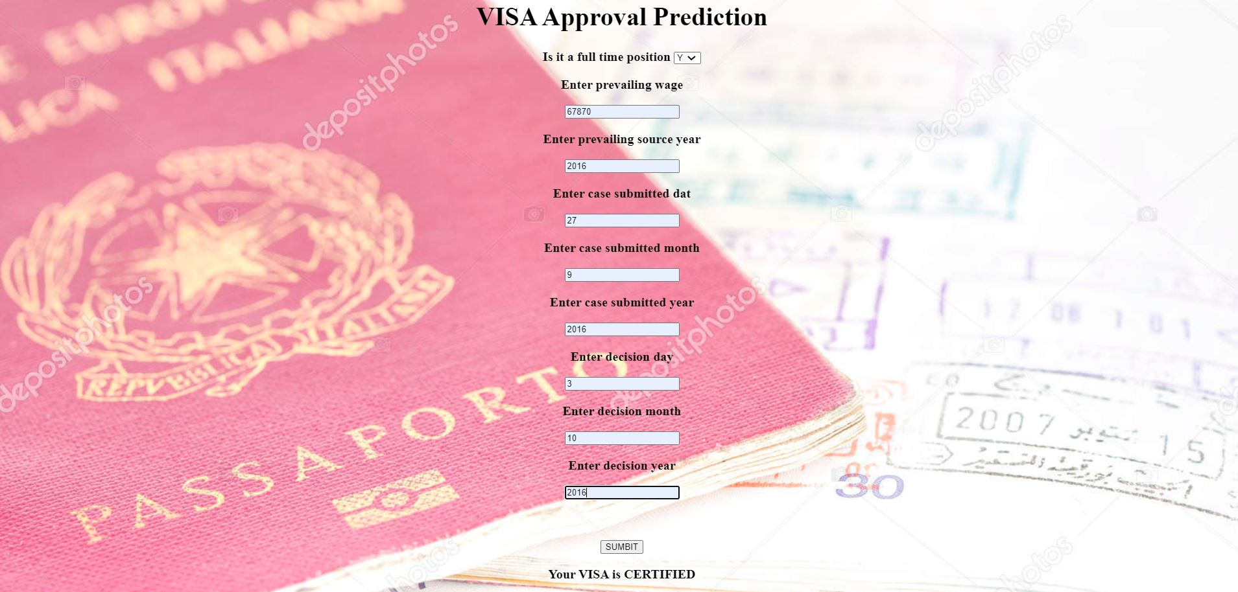
HTML PAGE

Slide 19
CONCLUSION
The process of filtering out and shortlisting the final applications takes some significant amount of time. So if we were able to predict the outcome, it would be very useful for applicants to analyze and plan their future accordingly without wasting precious amount of time especially during the prime period of their career. And even companies would also be benefited such that they can make efficient business plans with the help of these predictions.
By considering various parameters and constructing the apt machine learning models, it was possible to predict this outcome with a decent level of accuracy
The original purpose of the project is to predict the outcome of H-1B visa applications that are filed by many foreign By leveraging the advantages of some of the bleeding edge technologies like ML, we can predict some outcomes and can help millions of individuals out there.

Slide 20
THANK YOU
BATCH 10:
VIVEK, 121710303002
SANNIHITHA, 121710303062
SOUMIT, 121710303047
PRIYANKA, 121710303062

